Slide 1
Studiu de caz : firewall linux
Curs 10

Slide 2
Prima generatie filtrare de pachete
1988 de Digital Equipment Corporation
Inspecteaza pachetele ce reprezinta unitatea de baza in transferul da date
Daca un pachet nu indeplineste regulile din firewall poate fi DROP sau REJECT

Slide 3
A doua generatie
"stateful" filters
1989-1990 AT&T Bell Laboratories
Inspecteaza continutul pachetelor sa cada “care a cui este”

Slide 4
Iptables / ipchain
Nu este o diferenta majora
Folosind ipchains trebuie sa scriem reguli de INPUT, FORWARD si OUTPUT
Folosind iptables trebuie sa scriem reguli de INPUT numai pentru pachetele care circula in interior si FORWARD numai pentru pachetele care trec prin el iar OUTPUT pentru cele generate local
Notes:
The primary difference which should persuade you to use ipchains is as
follows:
- with ipchains you will need to write a rule for the input, forward
and output chains, as each and every packet goes through each of
these chain. This usually leads to a very complex script even for a
simple packet filter.
- with iptables you will need to write rules as follows:
input rules only for packets with the destination IP on the local box
forward rules only for packets passing through the local box
output rules only for packets generated on the local box

Slide 5
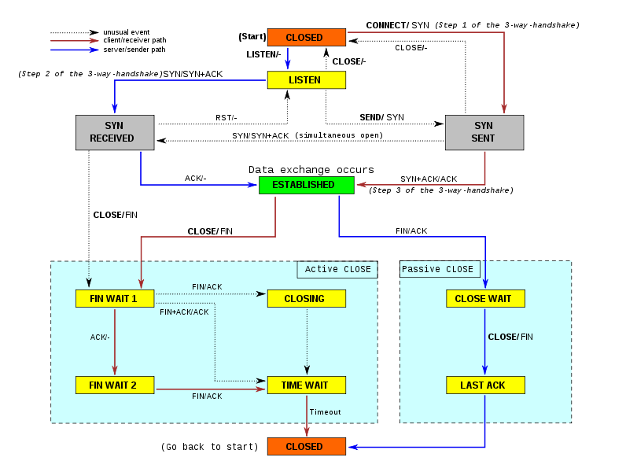
TCP STATE

Slide 6
LISTEN
SYN-SENT
SYN-RECEIVED
ESTABLISHED
FIN-WAIT-1
FIN-WAIT-2
CLOSE-WAIT
CLOSING
LAST-ACK
TIME-WAIT
CLOSED
LISTEN represents waiting for a connection request from any remote TCP and port. (usually set by TCP servers) SYN-SENT represents waiting for the remote TCP to send back a TCP packet with the SYN and ACK flags set. (usually set by TCP clients) SYN-RECEIVED represents waiting for the remote TCP to send back an acknowledgment after having sent back a connection acknowledgment to the remote TCP. (usually set by TCP servers) ESTABLISHED represents that the port is ready to receive/send data from/to the remote TCP. (set by TCP clients and servers) TIME-WAIT represents waiting for enough time to pass to be sure the remote TCP received the acknowledgment of its connection termination request. According to RFC 793 a connection can stay in TIME-WAIT for a maximum of four minutes.

Slide 7
IPTABLES comenzi
-A / --append – introduce o noua regula in sir
-D / --delete – sterge o regula din sir
-I / --insert – insereaza o regula la inceput sau unde se specifica in sir
-R / --replace – Inlocuieste o regula
-F / --flush - goleste sirul de reguli
-L / --list – Afisieaza toate regulile
-N--new-chain – creeaza un nou sir
-X--delete-chain – Sterge un sir
-P--policy – Seteaza politica default pentru un sir
-E--rename-chain – redenumeste un sir

Slide 8
IPTABLES optiuni
-s--source - adresa sursa a pachetului
-d--destination – adresa destinarul a pachetului
-i--in-interface – interfata pe care vine pachetul
-o--out-interface – interfata pe care pleaca plachetul
-p--protocol Protocol:
  TCP
    --sport port[:port]
    --dport port[:port]
    --syn
  UDP
  ICMP
  MAC
-j--jump – unde sa trimita pachetul

Slide 9
IPTABLES optiuni
-c--set-counters – seteaza un nr pe pachet
-m tcp –tipul de TCP
  --source-port port[:port]
  (port # or range #:#)
  --destination-port port[:port]
  --tcp-flags -m state
  --match state --state
  °ESTABLISHED
  °RELATED
  °NEW
  °INVALID

Slide 10
IPTABLES politici
ACCEPT – Lasa pachetele sa treaca
DROP – Respinge pachetele fara raspuns
REJECT - Respinge pachetele si raspunde trimitatorului
MASQUERADE Used with nat table and DHCP.
SNAT valabil inainte de rutare ( PREROUTING)
DNAT Valabil dupa rutare (POSTROUTING)
REDIRECT - utilizat cu NAT
LOG – face loguri si specifica mesajul:
--log-level #
--log-prefix "prefix“
--log-tcp-sequence
--log-tcp-options
--log-ip-options

Slide 11
IPTABLES exemple
INPUT
$ipf -A INPUT -s 127.0.0.1 -j ACCEPT
$ipf -A INPUT -s 193.231.19.17 -j ACCEPT
$ipf -A INPUT -s 193.231.20.2 -j ACCEPT
$ipf -A INPUT -s 193.0.225.13 -j ACCEPT
$ipf -A INPUT -s 172.25.8.1 -j ACCEPT
$ipf -A INPUT -s 172.25.0.1 -j ACCEPT
PORTURI
$ipf -A eth0 -s 193.0.225.1 -d 193.0.225.13 -p tcp --dport 25 -j ACCEPT #mail
$ipf -A eth0 -s 193.231.19.82 -d 193.0.225.13 -p tcp -m multiport --dports 25,110 -j ACCEPT #mail from stuff john
$ipf -A eth0 -s 193.0.225.17 -d 193.0.225.13 -p tcp --dport 25 -j ACCEPT #mail de pe mail-exchange(bradu)
$ipf -A eth0 -s 193.0.225.1 -d 193.0.225.13 -p udp --sport 53 -j ACCEPT #DNS
$ipf -A eth0 -s 193.0.225.24 -d 193.0.225.13 -p tcp --dport 143 -j ACCEPT #webmail
PREROUTING
$ipf -t nat -A PREROUTING -p tcp -d 193.0.225.13 --dport 8081 -j DNAT --to 172.25.0.10:8080
POSTROUTING
$ipf -t nat -A POSTROUTING -p tcp -s 172.25.8.0/22 -d 193.231.20.42 -m multiport --dports 5432 -j SNAT --to-source 193.0.225.13
$ipf -t nat -A POSTROUTING -p tcp -s 172.25.9.199 -d 193.231.20.12 -m multiport --dports 6991,8991,80 -j SNAT --to-source 193.0.225.13

Slide 12
IPTABLES exemple
$ipf -N intern #chain pentru tot ce vine din interior
$ipf -A INPUT -i eth1 -j intern
$ipf -A INPUT -i eth2 -j intern
$ipf -A INPUT -i eth3 -j intern
$ipf -A intern -p tcp -m multiport --ports 22,80,443,110,25 -j ACCEPT
$ipf -A intern -p tcp --dport 3306 -s 172.25.8.252 -j ACCEPT
$ipf -A intern -p udp --dport ntp -j ACCEPT
$ipf -A intern -s 172.25.8.252 -j ACCEPT
$ipf -A intern -p tcp --dport 3306 -s 172.25.8.251 -j ACCEPT
$ipf -A intern -j DROP

Slide 13
Protocoale VPN
IPsec
HIP Host Identity Protocol
L2F Layer 2 Forwarding Protocol
L2TP Layer 2 Tunneling Protocol
PLIP Parallel Line Internet Protocol
PPTP Point-to-Point Tunneling Protocol
PPP Point-to-Point Protocol
SLIP Serial Line Internet Protocol
SSL/TLS Secure Sockets Layer / Transport Layer Security

